Slide 1


COSTMAP: OPTIMIZING FINANCIAL TRANSACTIONS
Mapping the cost of mobile money in SMES in Kenya

Slide 2

TEAM
Sheilla achieng’
Favour mwangi
Pearl rowe
Project Manager
Front-end Developer
Market Researcher
Data Analyst
Dennis mbuno
ALLAN CHIKOMBE
Front-end Developer
Back-end Developer

Slide 3

PROBLEM
High Transaction Fees.
Pain Point: SME Business Owners.
Significance of finding a solution
A. Profitability Reduction in SMEs

Slide 4
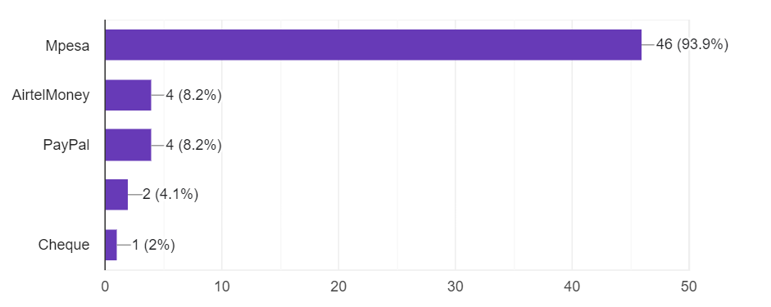
outcome
FINDINGS
Lack of competition between mobile money operators.
A large portion of SMEs use mobile money services in their daily business transactions
Preference of mobile money services.
Transaction Costs impact pricing of goods and services.
More to be found on our website.
Responses to a survey question conducted :Which mobile money service(s) do you use?

Slide 5

COSTMAP
CostMap is a an advisory software tool that will: track, analyze and mobilize money transactions for SMEs.
Key Features: Real Time Cost Tracking
Detailed Analysis
Regular reports
Financial literacy resources

Slide 6
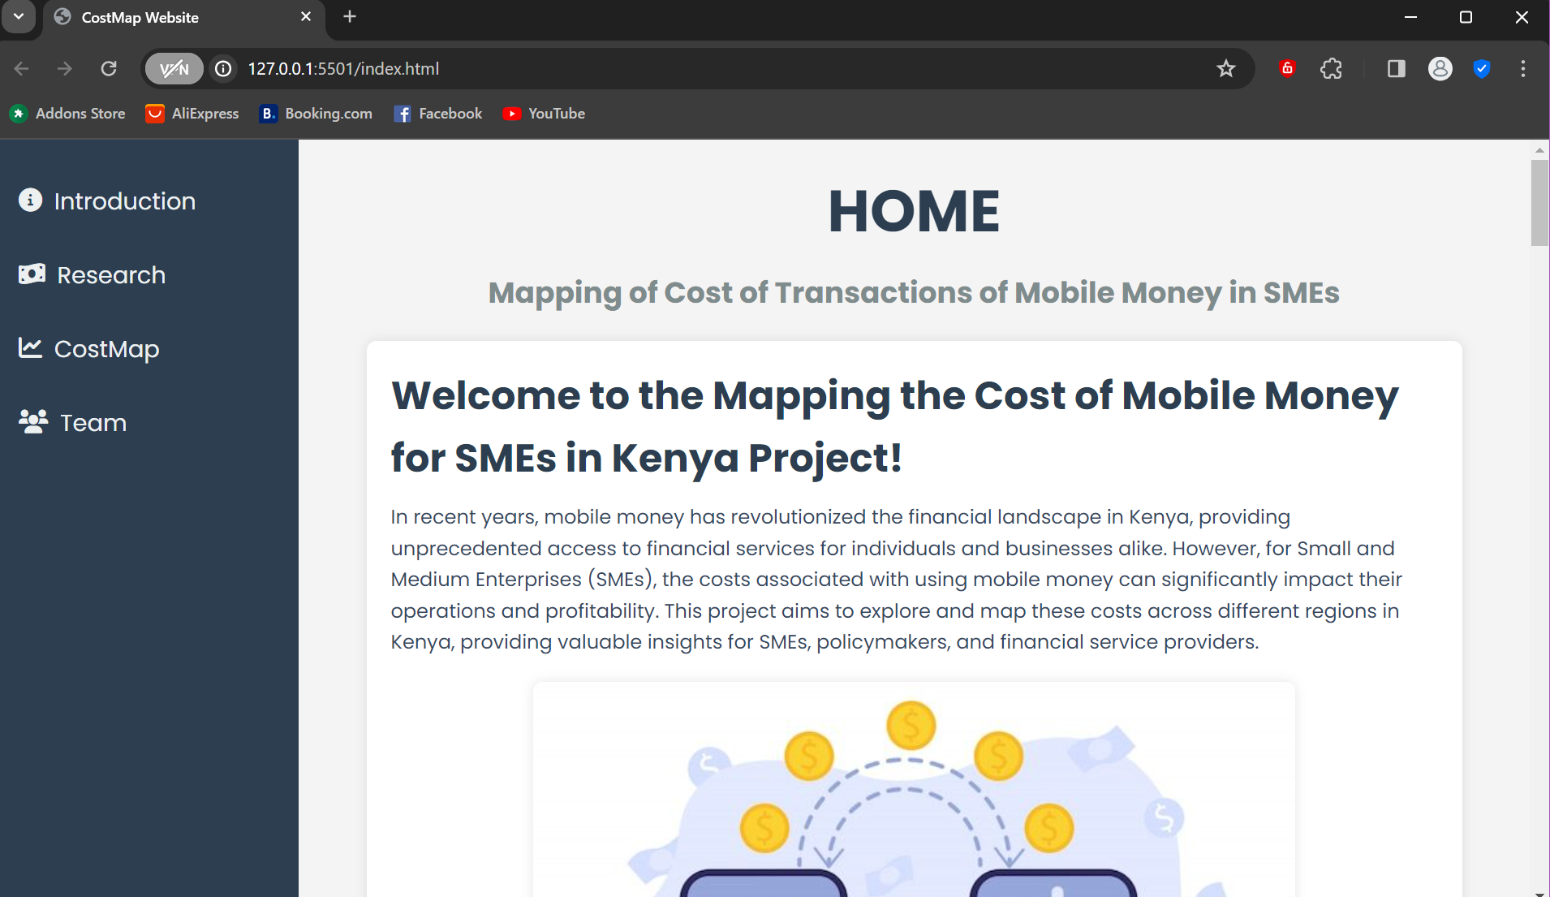
website
Still in progress.
Entails more detail of our project.

Slide 7

NEEDS
​DATA ACQUISITION
Team needs to acquire data to analyze and implement to find a suitable solution.
Software tools
We need subscription to some software tools in order to come up with a suitable solution.

Slide 8

Obstacles
DATA ACCURACY
The data collected might not be accurate.
It might also be outdated.
​
SAMPLE SIZE
Collecting data from too few businesses may lead to biased results while collecting from too many may be resource-intensive.

Slide 9
THANK YOU
RESOURCES
PPT TEMPLATE BY:MIRJAM NILLSON
PICTURES FROM:REDBULL
PINTEREST
GOOGLE

